Slide 1
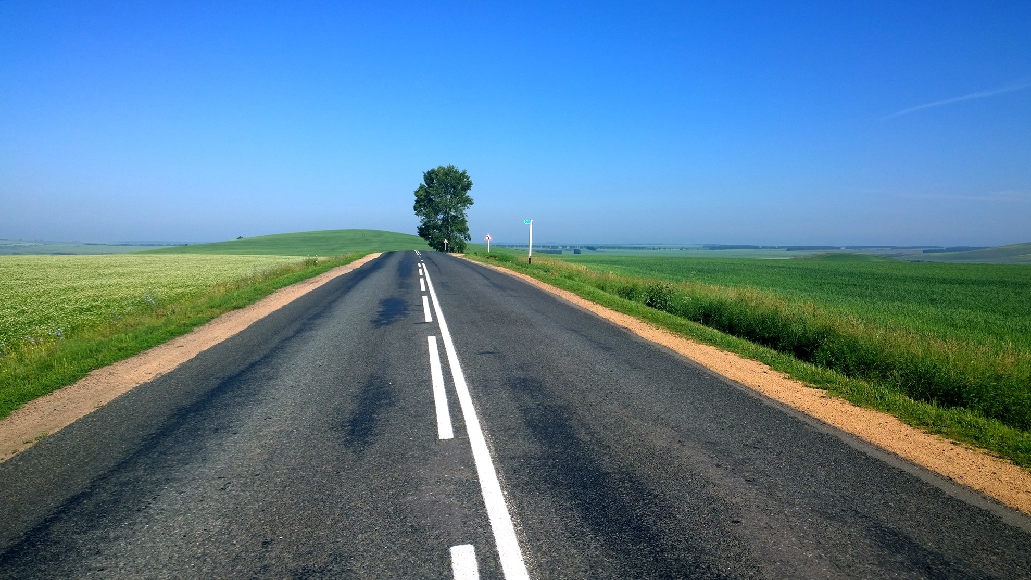
National Parks Locator
This is what happens when Google Maps API makes sweet love with the NPS API.

Slide 2
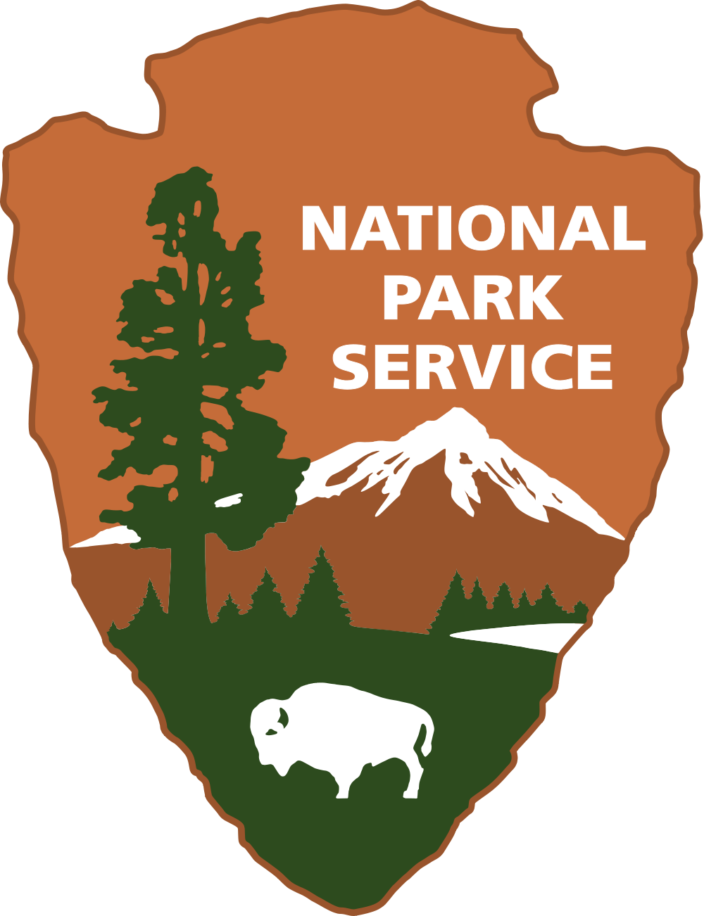
Our Motley Crew
Charles Loyd
Travis Barnes
Logan Hasty
Brian Harding
Stephen Voss

Slide 3
Overview
The National Park Locator App is designed to provide the end user with the nearest path to the closest National Park. This is done through magically combining the Google Maps API with the National Park API to provide the end user with directions to the nearest national treasure.

Slide 4
